Slide 1

Determination of major and minor mutations in sequencing data from mixed infections
Malte Hallgren, PhD student
Philip Clausen, PostDoc

Slide 2
Learning objectives of today
Understand the concept of mixed infections
Understand the concepts of major and minor variants
Become familiar with the VCF format
Understand how to calculate relevant variant statistics from KMA output files

Slide 3
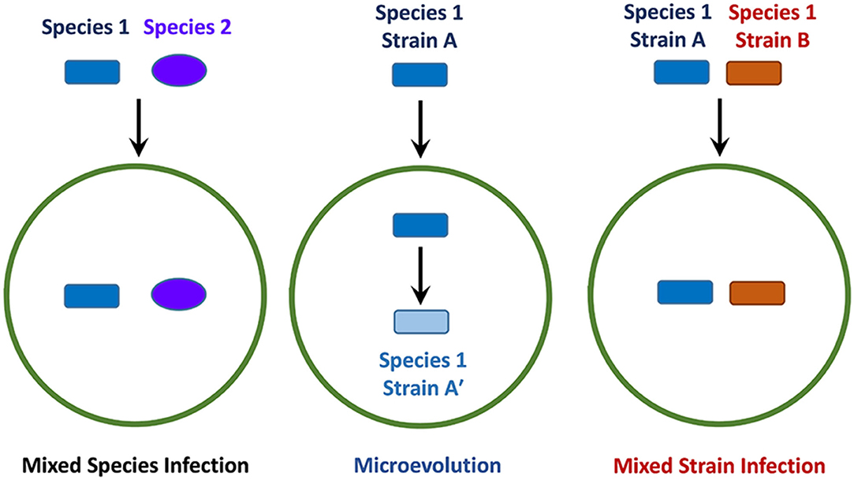
What is a mixed infection?

Slide 4
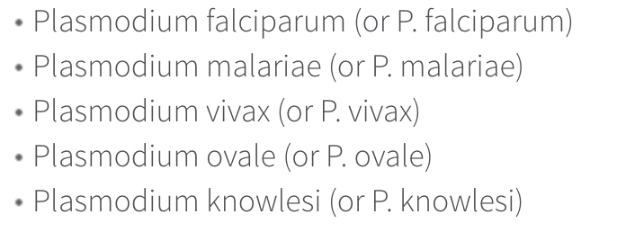
Malaria

Slide 5
Covid Variants
Types
Wild Type (WT)
Alpha (b.1.1.7, UK)
Beta (b.1.351, South Africa)
Gamma (p.1, Brazil)
Delta (b.1.617.2, India)
Omicron (b.1.1.529, South Africa)
PCR vs Sequencing

Slide 6
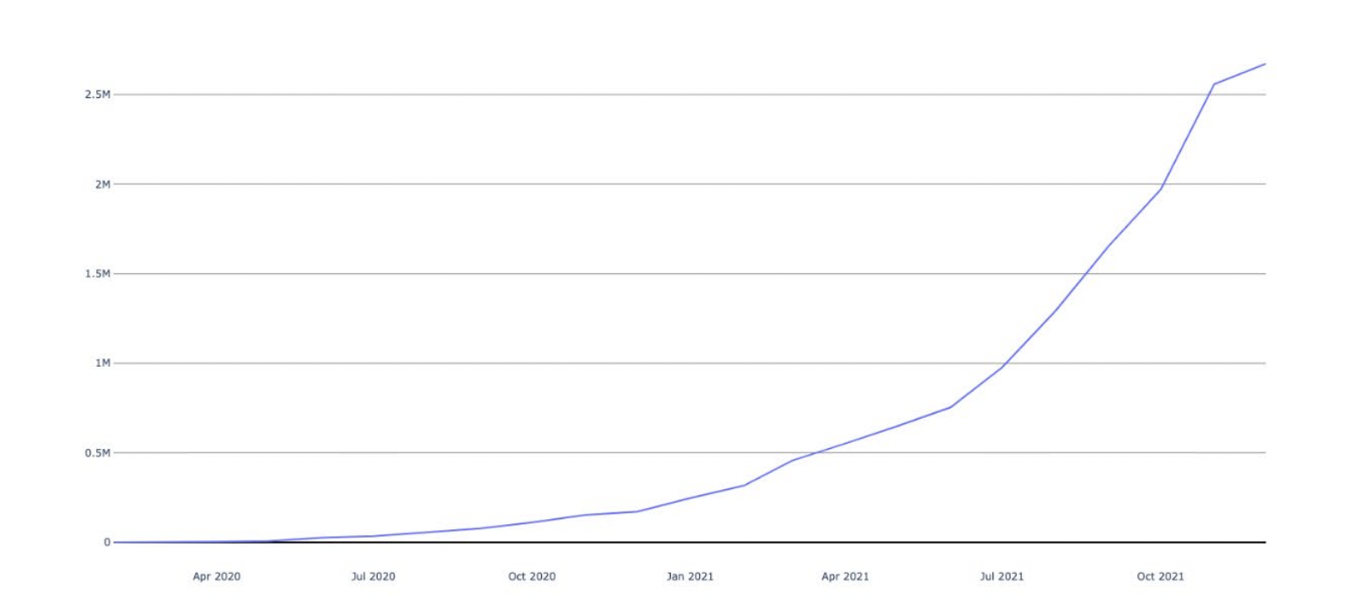
Covid sequencing

Slide 7
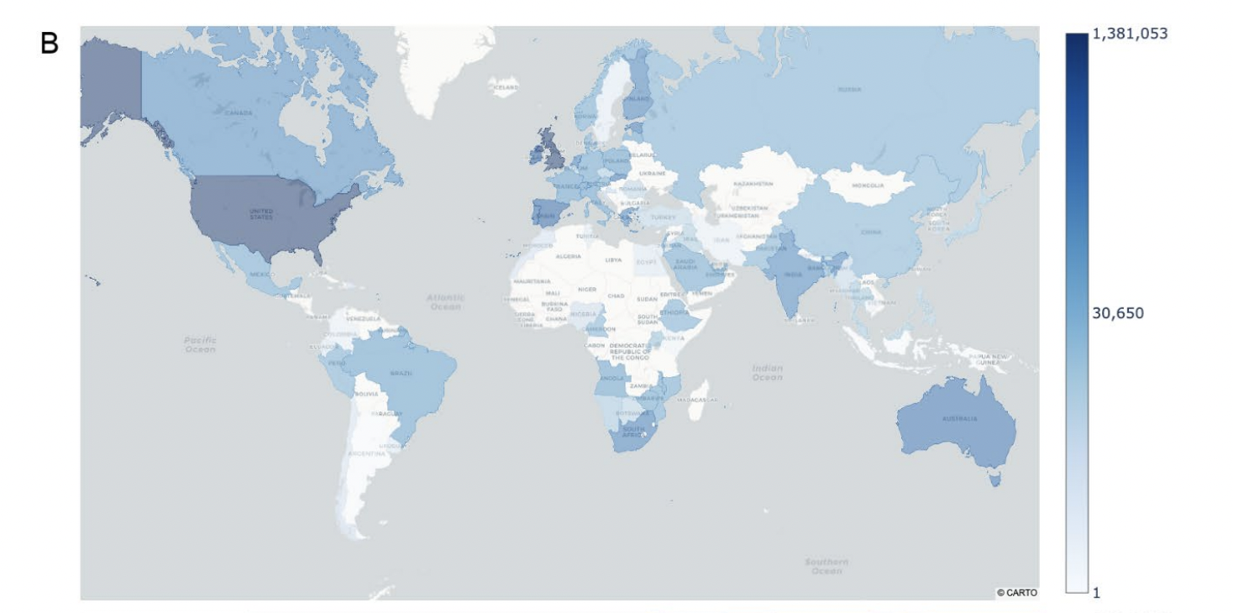
Covid sequencing

Slide 8
Majority and minority variants
Majority: Circles (4)
Minority: Triangles and Squares (3)
Often we only report the majority variant as the identified variant

Slide 9
Why are minor variants important?
Every variants was at some point a minor variant
Sustained growth in a minor variant could mean enhanced functionality
Allows for tracing of variants prior to them becoming public health challenges

Slide 10
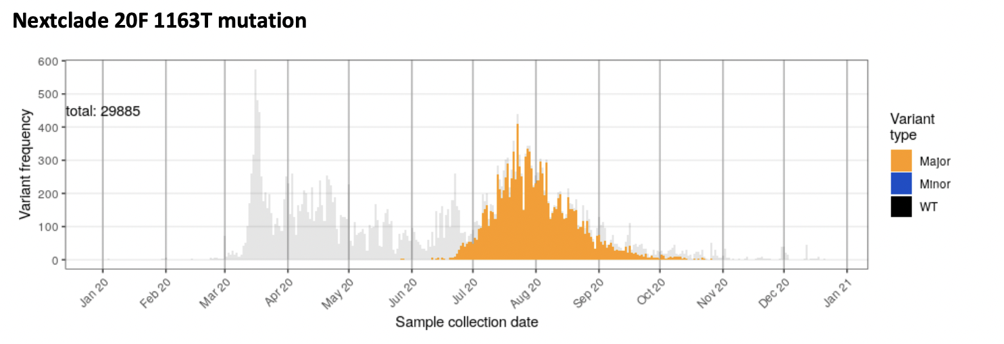

Slide 11
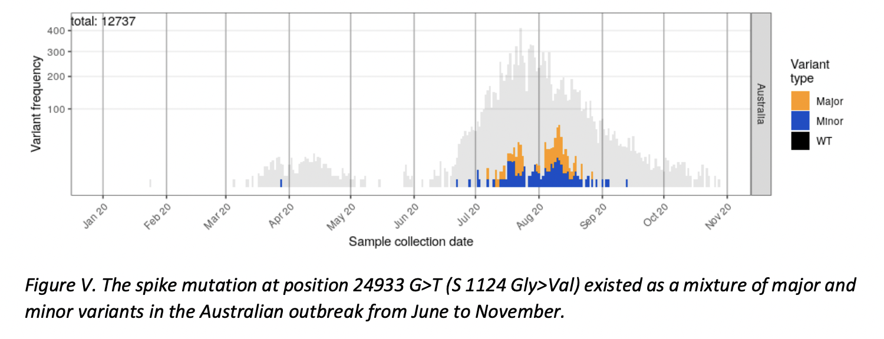

Slide 12
How do we identify variant mixtures?
Sequencing
Alignment (KMA, BWA)
Consider each individual alignment
Count number of observed nucleotides at each position

Slide 13
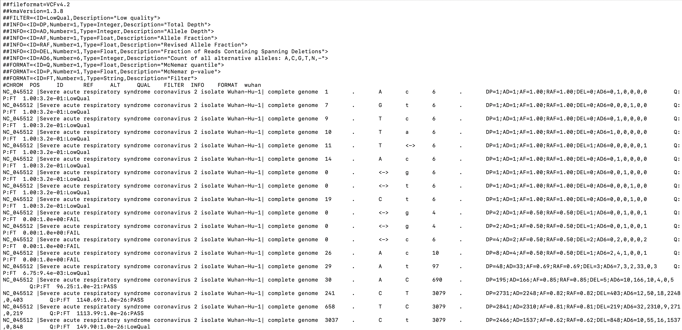
Variant Call Format (vcf)

Slide 14
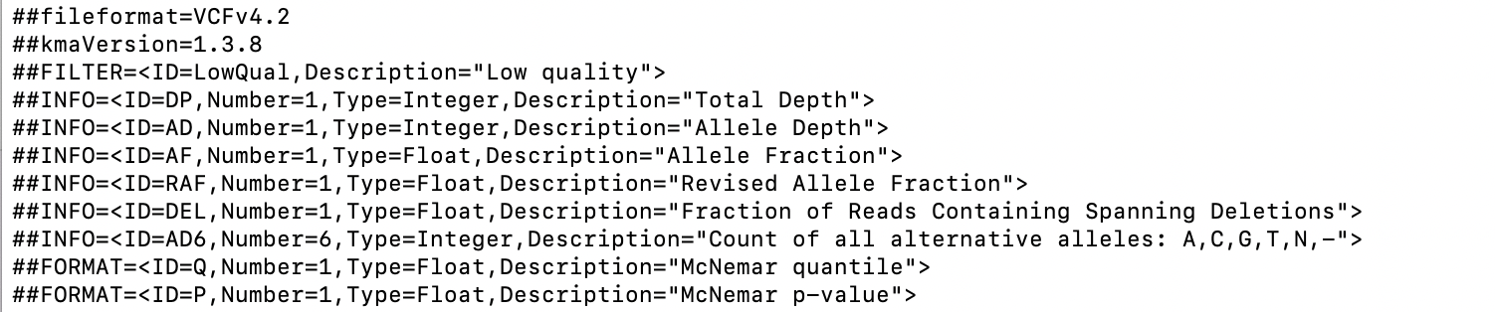
VCF DP, AD, AF, RAF, AD6
DP=2841;AD=2310;AF=0.81;RAF=0.81;DEL=219;AD6=32,2310,9,271,0,219

Slide 15
Now you try!
Task: Make a majority and minority typing pipeline
Step 1: KMA alignment
Step 2: Python script to evaluate KMA VCF for typed variants
Step 3: Output result

